Slide 1
Lecture 9
cis-, trans-isomerism

Slide 2
Draw a correct Lewis structure for this compound:
1-sec-butyl-3-isopropyl-4-methylcyclopentane

Slide 3
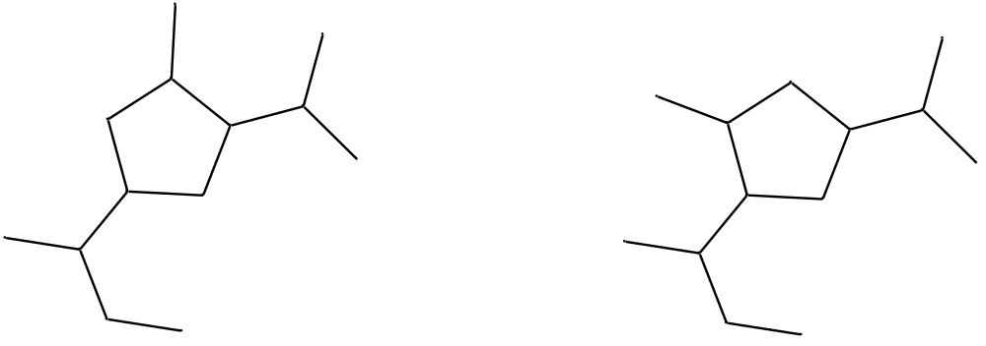
What sort of isomers are these?

Slide 4
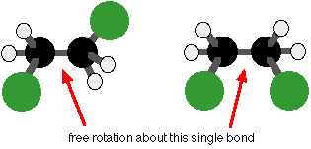
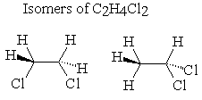
Conformational isomers: rotation about
a single bond converts one to the other.
Constitutional isomers: one or more bonds
must be broken to convert one to the other.

Slide 5
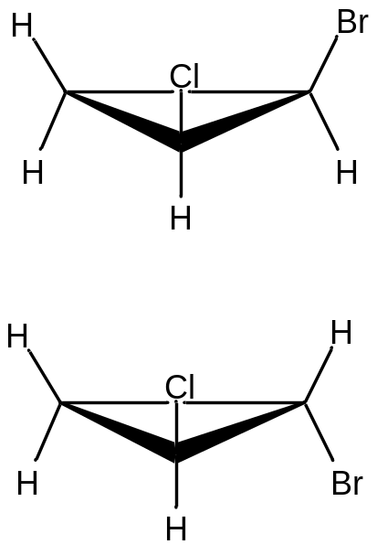
cis-
trans-
cis-, trans-Isomerism:
The same molecular formula
The same connectivity of atoms
An arrangement of atoms in space
that cannot be interconverted by rotation about a single bond
To convert these isomers, bonds must be broken
Constitutional isomers: different connectivity of atoms
Conformational isomers: interconverted by rotation
about a single bond

Slide 6
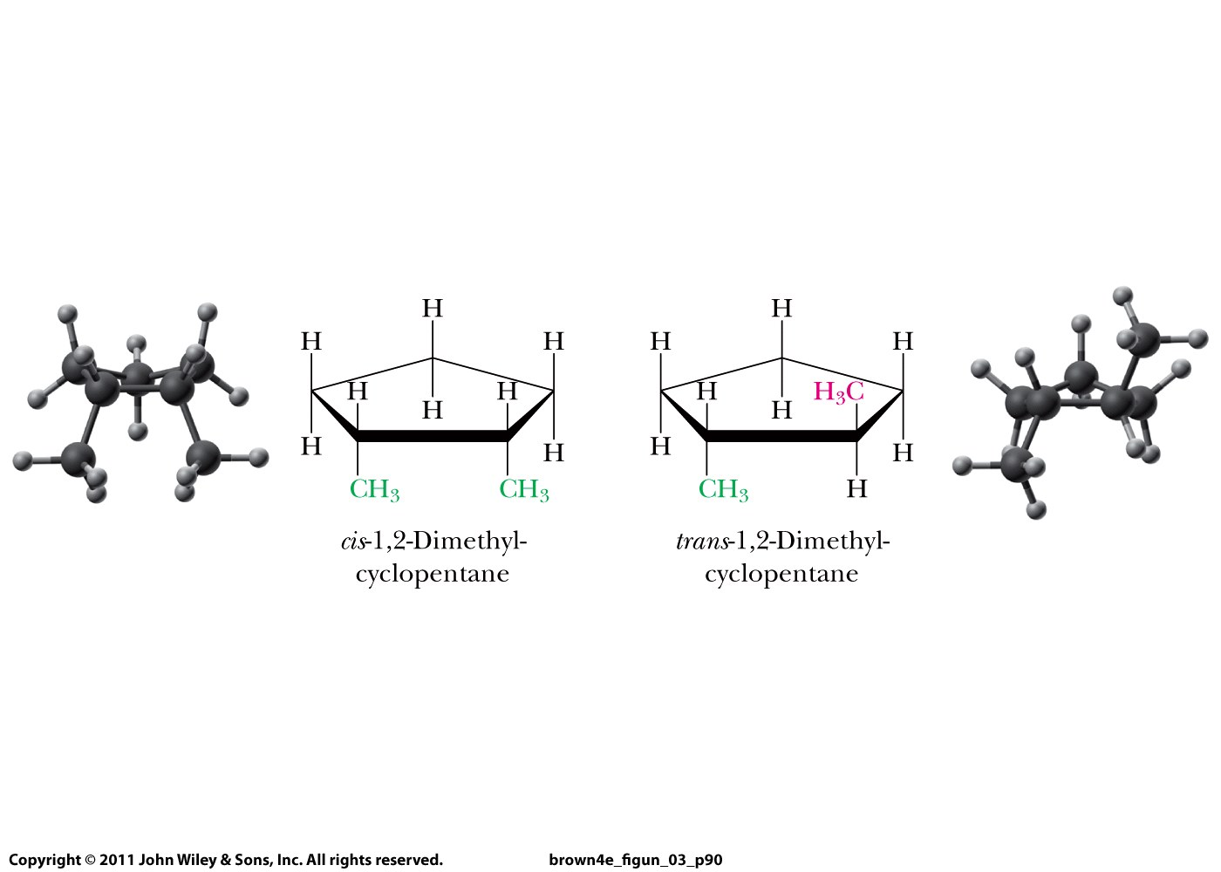
cis-, trans-Isomerism
Lower case letter
In italics

